Slide 1
Low Level Virtual Machine C# Compiler
Senior Project Final Presentation
Prabir Shrestha (4915302)
Myo Min Zin (4845411)
Napaporn Wuthongcharernkun (4846824)

Slide 2
Agenda
Introduction
The Framework
Scanner/Parser
Semantic Analysis
Code Generation & Garbage Collection
Questions and Answers

Slide 3
Introduction-Project Overview
C# Source File (.cs)
Compiler
Low Level Virtual Machine Intermediate Representation (.ll)
Source Language
Target Language
Notes:
- It’s a naïve compiler that accept C# as a source language and LLVM as the target language

Slide 4
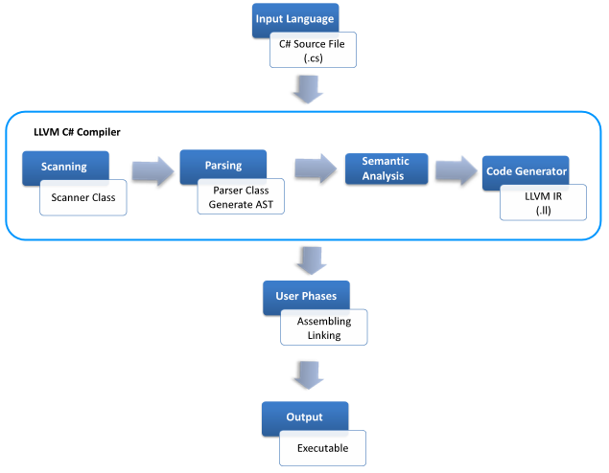
Introduction-Overall Process

Slide 5
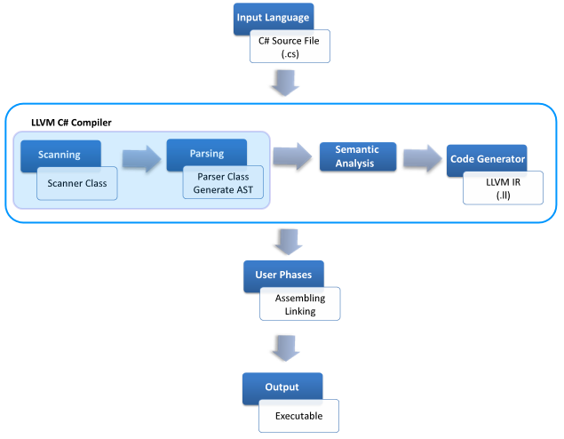
Introduction-Overall Process

Slide 6
Scanner
Tokenization Process- Identifying the tokens from the input stream.
Skip meaningless characters, white spaces,
Lexical Analysis- Checking for Lexical Errors
Using Coco/R tool the scanner and parser are generated at the same time.

Slide 7
Parser
Syntax Analysis is performed at this phase.
Coco/R generates a recursive descent parser.
Top down parsing method
Procedural-like functions
Generally for each production rule, one procedure is generated.
Accepts Grammar in LL(k) Form
LL(1) Conflict Resolvers are used
LL: Left to Right, Left most Derivation

Slide 8
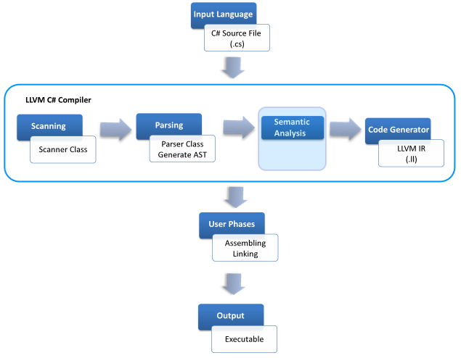
Overall Process

Slide 9
Semantic Analyzer
A phase that follows after the generation of parser
To check semantic error once the lexical and syntax errors have been checked
Examples:
type checks, scoping of variable, constant values not being changed, no redefinitions of a classes, method and member variables

Slide 10
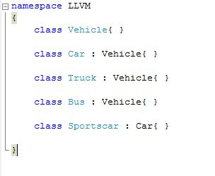
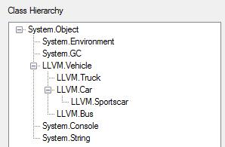
Class Hierarchy
Vehicle
Car
Sport Car
Truck
Bus

Slide 11
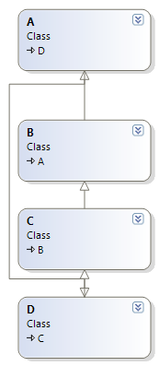
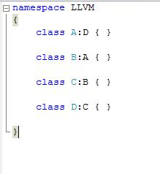
Class Hierarchy
Circular Inheritance
Notes:
+ boolean matrix other slides

Slide 12
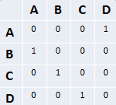
Circular Inheritance
Boolean Matrix Representation
Class Hierarchy
Notes:
Rows and columns represent the classes
It is marked ‘1’ for each corresponding row(class) that inherits from a column(class).

Slide 13
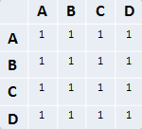
Circular Inheritance
Original Boolean Matrix
Boolean Matrix Result
Applied Formula where, Rank is no. of linearly independent rows in matrix
Notes:
Apply this formula to the boolean matrix then check the diagonals.

Slide 14
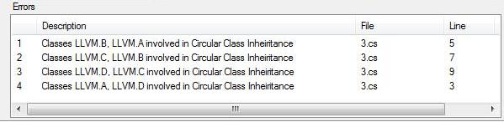
Circular Inheritance
Original Boolean Matrix
Boolean Matrix Result
Notes:
Apply this formula to the boolean matrix then check the diagonals.

Slide 15
Semantics – Method Table
Method Table
Constructors
Functions
Accessors
Operator Overloads
Type Conversions
Contained in each class and struct type

Slide 16
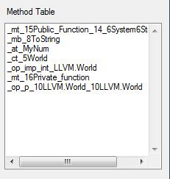
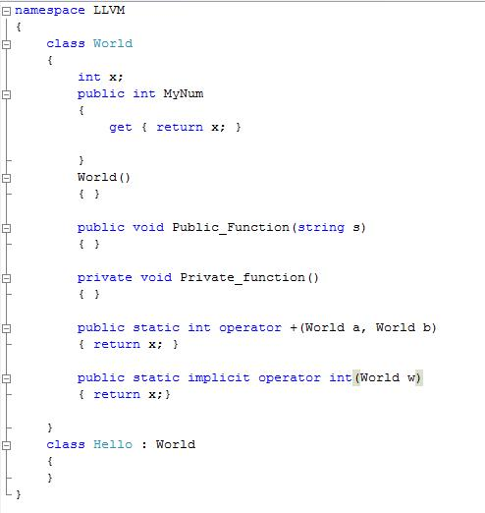
Semantics - Method Table

Slide 17
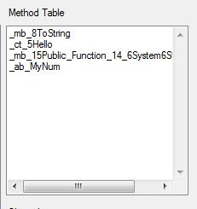
Semantics – Method Table

Slide 18
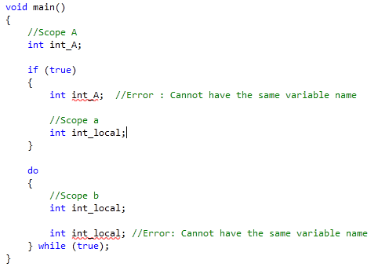
Semantics-Scope Checking
Checking scope of variables

Slide 19
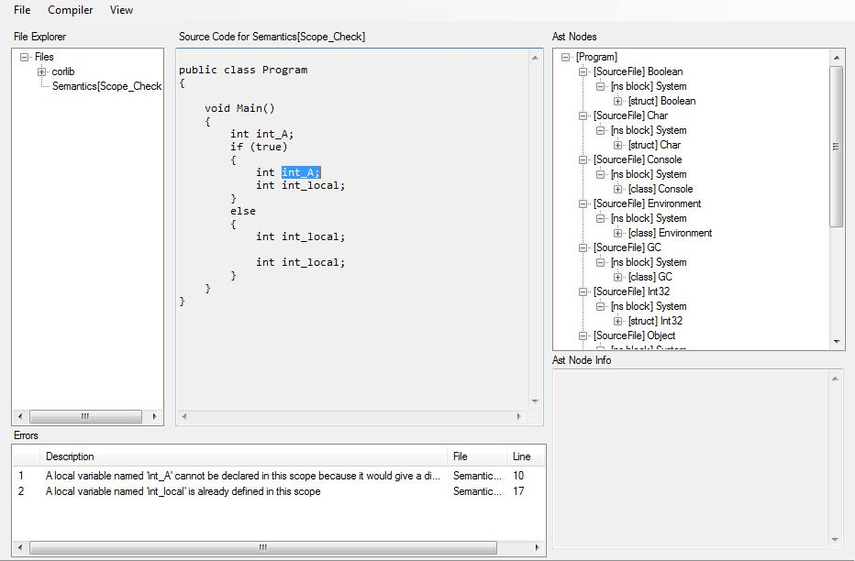
Semantics – Scope Checking

Slide 20
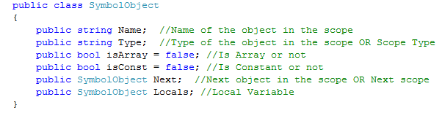

Scope Checking -Symbol Table

Slide 21
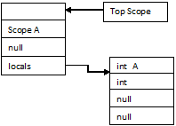
Scope Checking – Symbol Table

Slide 22
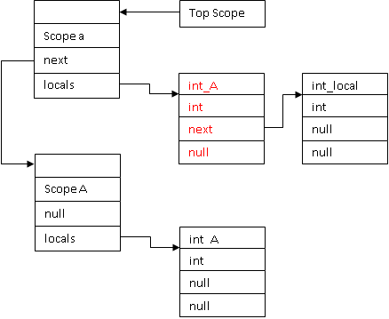
Scope Checking – Symbol Table

Slide 23
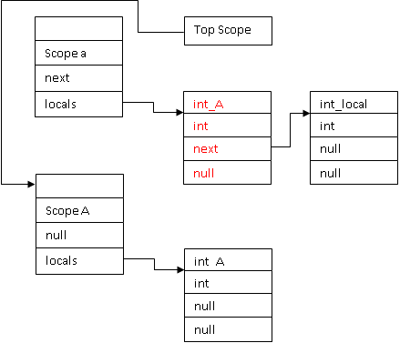
Scope Checking – Symbol Table

Slide 24
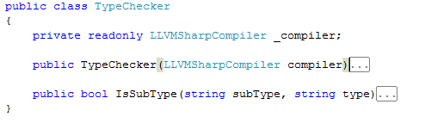
Type Checking

Slide 25
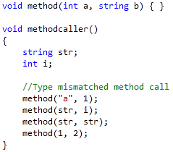
Semantics-Type Checking Methods
Method-call (Arguments)Type Checking

Slide 26
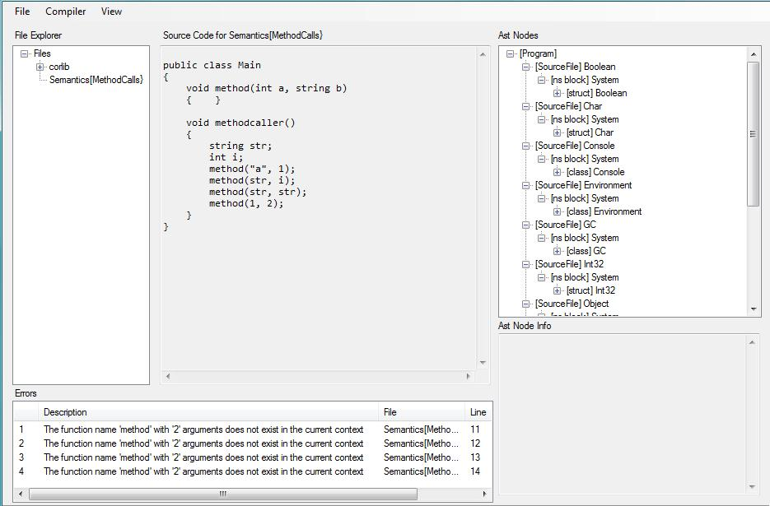
Semantics – Type Checking Methods

Slide 27
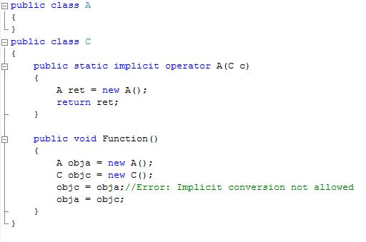
Semantics-Type Checking

Slide 28
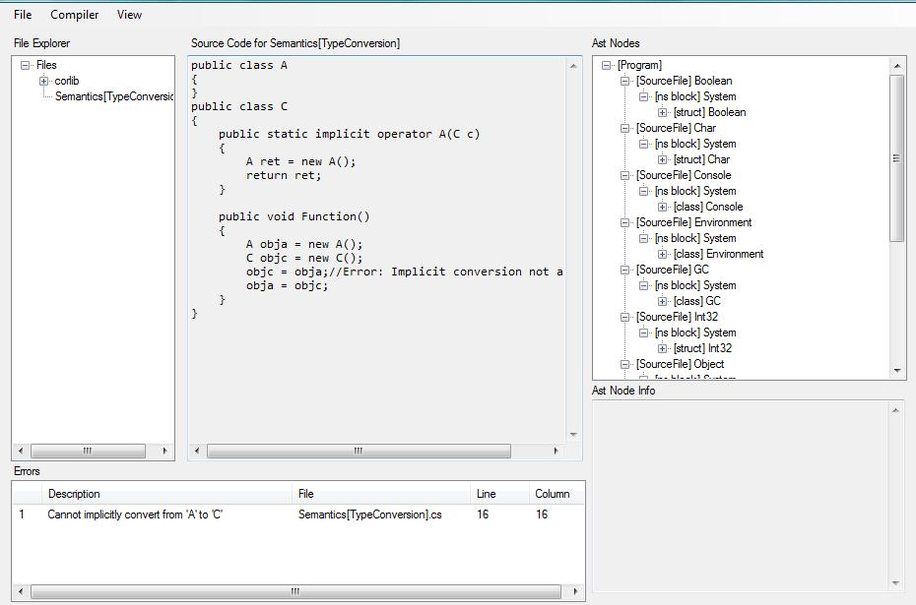
Semantics – Type Checking

Slide 29
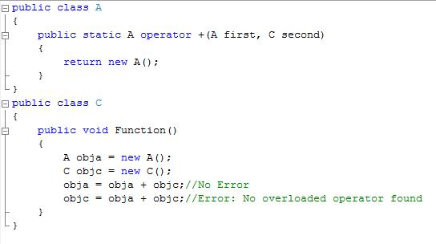
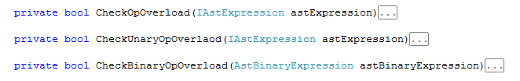
Semantics-Type Checking

Slide 30
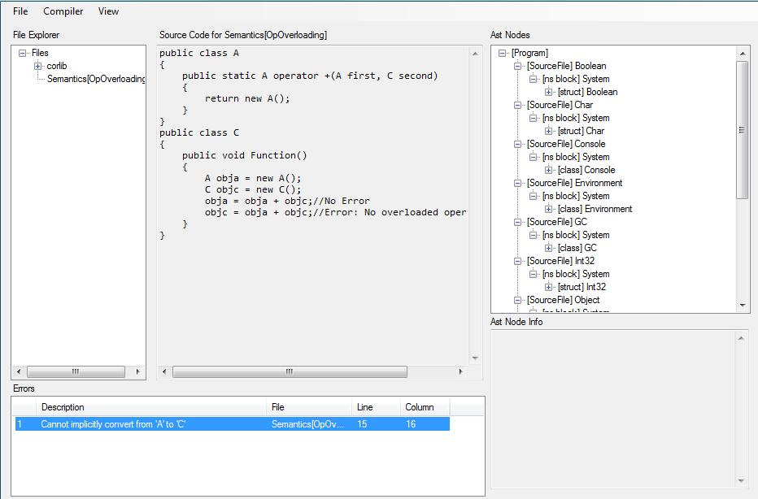
Semantics – Type Checking

Slide 31
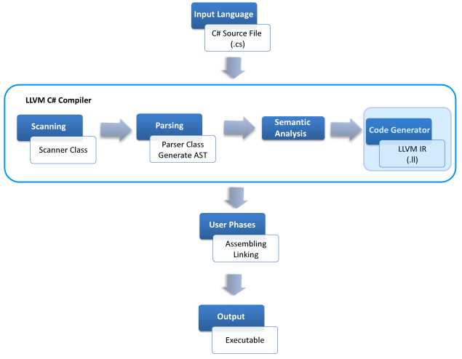
Overall Process

Slide 32
Low Level Virtual Machine Intermediate Representation (IR)
Language and Target independent
Designed to support multiple language frontends
Represents the key operations of ordinary processors
Avoids machine specific constraints
physical registers, pipelining
Notes:
Multiple language frontends – c/c++/c#/java – metadata, accurate gc
unbounded number of registers – later steps does register allocation, mapping virtual registers to real machine registers

Slide 33
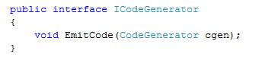
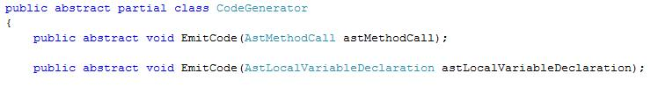
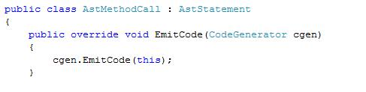
Code Generation
Code Generation Module

Slide 34

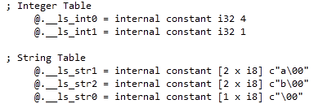
Integer & String Table
Integer & String Constants
Code Generated for Integer Table, String Table

Slide 35


Object Layout

Slide 36
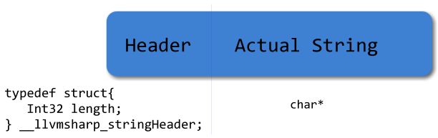
String Layout
Notes:
+ internals

Slide 37


Code Generation - Methods
Static Method
Non-static Method
Notes:
Highlight this pointer,
+ctor briefly

Slide 38
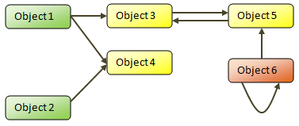
Garbage Collector
Green Nodes – Roots
Yellow Nodes – Reachable Objects Orange Nodes – Unreachable Objects
Notes:
+ mark and sweep alogrithm

Slide 39
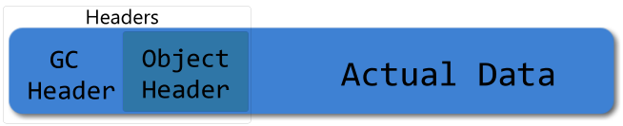
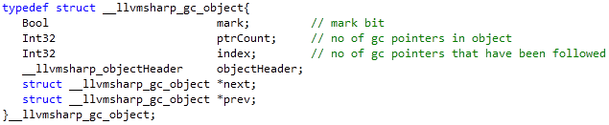
GC Storage Structure

Slide 40
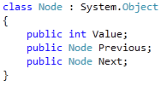
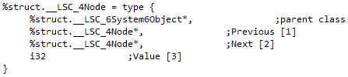
Garbage Collector

Slide 41
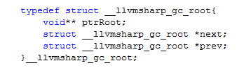

Garbage Collector - Roots

Slide 42
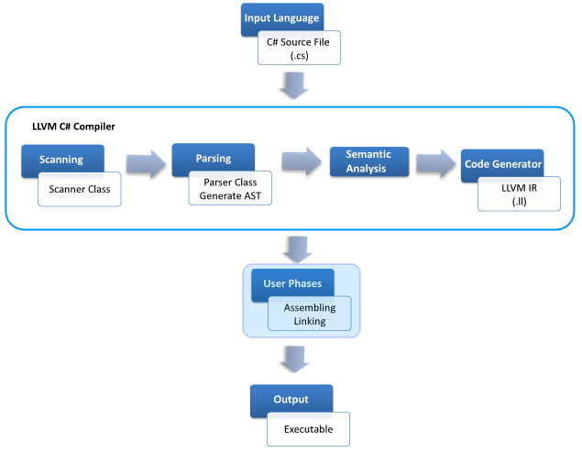
Overall Process

Slide 43
Assembling and Linking
User Phases
LLVM C# Compiler
LLVM Assembler (llvm-as)
LLVM Intermediate Representation (.ll)
Executable
LLVM Bitcode (.bc)
LLVM Linker (llvm-ld)
Notes:
We will be providing automatic feature to assemble and link further down.

Slide 44
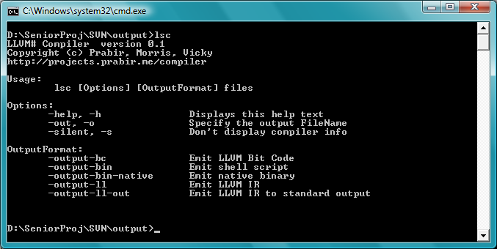
Command Line Options

Slide 45
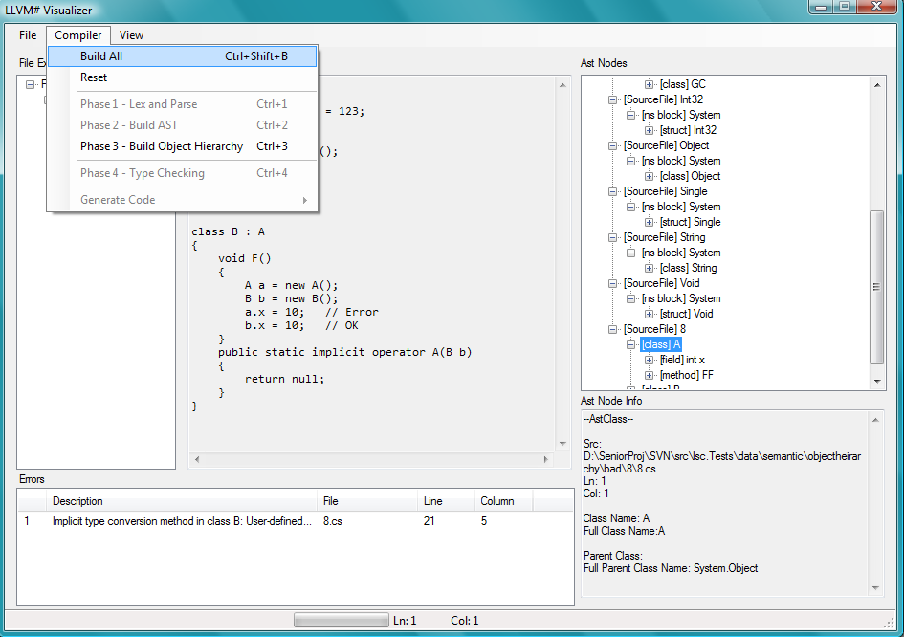
Visualizer

Slide 46
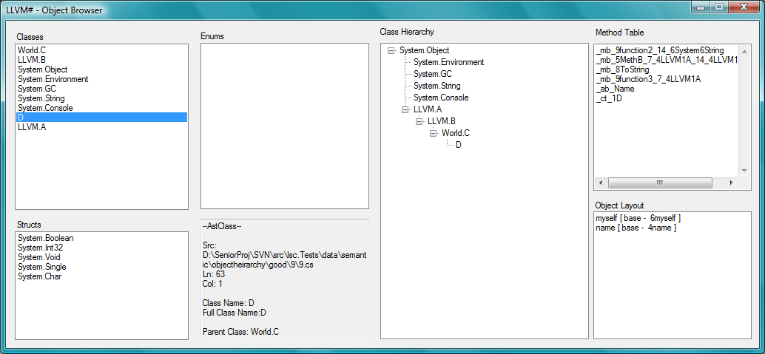
Object Browser

Slide 47
Demos

Slide 48

Questions and Answers

